Slide 1
Supervised Learning: Classification
Ayal Gussow

Slide 2
Supervised Learning Module
Supervised learning 1: Regression problems
Supervised learning 2: Overfitting, regularization, hyperparameter optimization, and cross-validation
Supervised learning 3: Classification problems

Slide 3
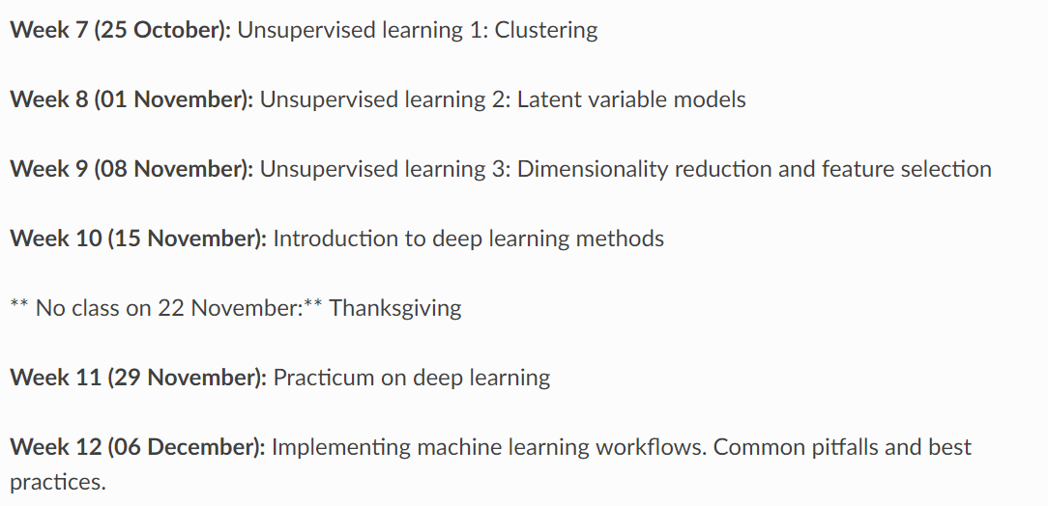
Supervised Learning Module

Slide 4
Supervised Learning Module
Training samples are provided with the desired output.
Example:
Predicting the price of a house based on its attributes.

Slide 5
Supervised Learning: Classification
Regression: The predicted variable takes continuous values (IE house prices).
Classification: The predicted variable takes labels (IE color).

Slide 6
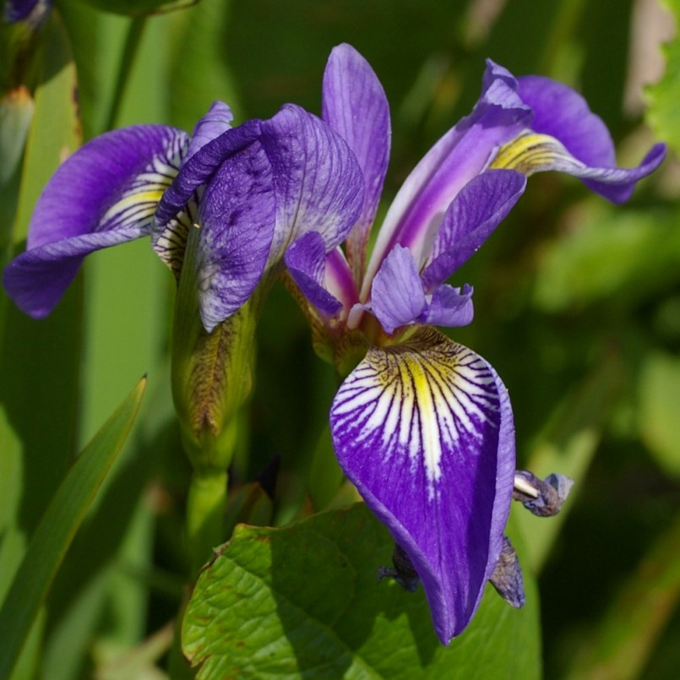
Iris Dataset
Petal length
Sepal length
Petal width
Sepal width
Species: Setosa

Slide 7
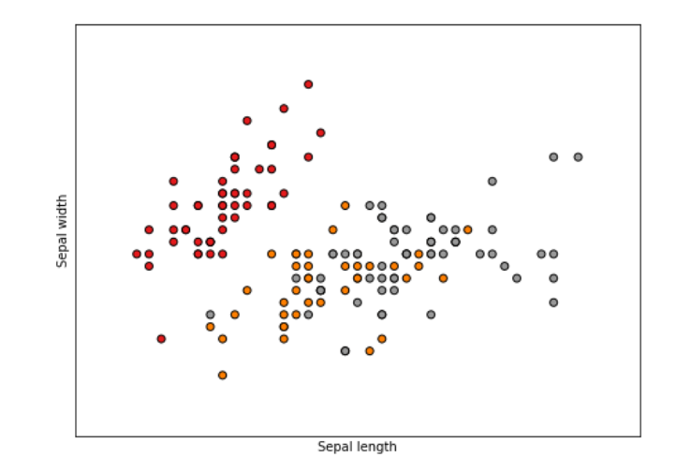
Iris Dataset
Dataset of flower measurements, 150 samples, 50 samples per class.
Classes:
Setosa
Versicolor
Virginica

Slide 8
Basic Problem
Given the sepal length and width of an iris flower, can you predict the flower’s species?

Slide 9
Today’s Outline
Classification algorithms.
Classification evaluations.
Homework assignment (a bit tougher than previous two).

Slide 10
Models (logistic regression, random forest, etc)

Slide 11
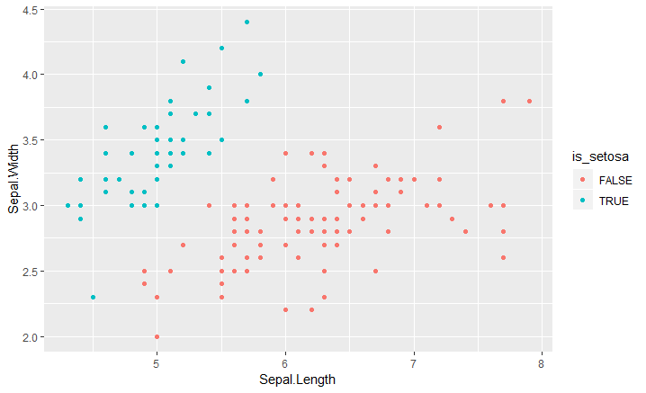
Scatterplot of Sepal Length, Sepal Width

Slide 12
Predict by sepal
We want to predict: Species
y – setosa (1) or not setosa (0).
X – sepal length, sepal width.

Slide 13
Predict by sepal
We want to predict: Species
y – setosa (1) or not setosa (0).
X – sepal length, sepal width.
$$y=Xβ$$
$y= β_{0}$ * 1 + $β_{1}$ * $X_{1}$ + $β_{2}$ * $X_{2}$

Slide 14
Predict by sepal
We want to predict: Species
$$y=Xβ$$
$y= β_{0}$ * 1 + $β_{1}$ * $X_{1}$ + $β_{2}$ * $X_{2}$
y has to be 0 or 1.
Logistic function:
$$f(z)=\frac{1}{1+e^{−z}}$$

Slide 15
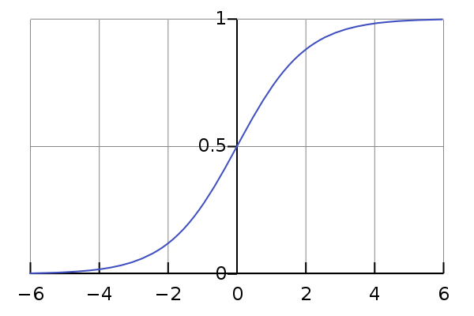
Predict by sepal
We want to predict: Species
$$y=Xβ$$
$y= β_{0}$ * 1 + $β_{1}$ * $X_{1}$ + $β_{2}$ * $X_{2}$
y has to be 0 or 1.
Logistic function:
$$f(z)=\frac{1}{1+e^{−z}}$$

Slide 16
Predict by sepal
Logistic function:
$$f(z)=\frac{1}{1+e^{−z}}$$
Will return number between 0 and 1.
If it’s greater or equal to 0.5: 1
Else: 0.

Slide 17
Predict by sepal
Logistic function:
$$f(z)=\frac{1}{1+e^{−z}}$$
$y= β_{0}$ * 1 + $β_{1}$ * $X_{1}$ + $β_{2}$ * $X_{2}$
If f(y) >= 0.5: Setosa.
Else: Not setosa.

Slide 18
Predict by sepal
$$y=\frac{1}{1+e^{−Xβ}}$$
If $Xβ>0: y=1$.
$$β_{0}+β_{1}∗SW+β_{2}∗SL>0$$

Slide 19
Predict by sepal
$$y=\frac{1}{1+e^{−Xβ}}$$
If $Xβ>0: y=1$.
$$β_{0}+β_{1}∗SW+β_{2}∗SL>0$$
$437.2−163.41∗SW+137.93∗SL$ > 0
$163.41∗SW−137.93∗SL$ > $437.2$: y=1

Slide 20
Predict by sepal
$$y=\frac{1}{1+e^{−Xβ}}$$
If $Xβ>0: y=1$.
$$β_{0}+β_{1}∗SW+β_{2}∗SL>0$$
$437.2−163.41∗SW+137.93∗SL$ > 0
$163.41∗SW−137.93∗SL$ = $437.2$

Slide 21
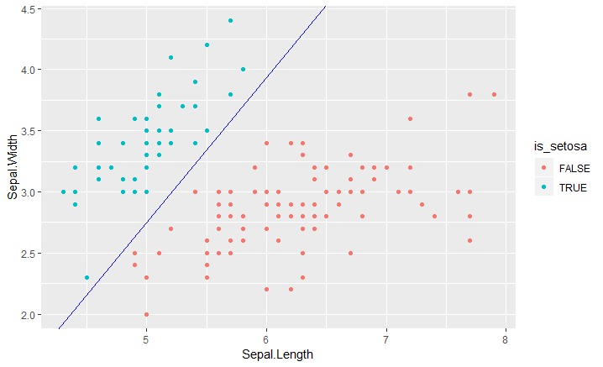
Predict by sepal
$$y=\frac{1}{1+e^{−Xβ}}$$
If $Xβ>0: y=1$.
$$β_{0}+β_{1}∗SW+β_{2}∗SL>0$$
$163.41∗SW−137.93∗SL$ = $437.2$

Slide 22
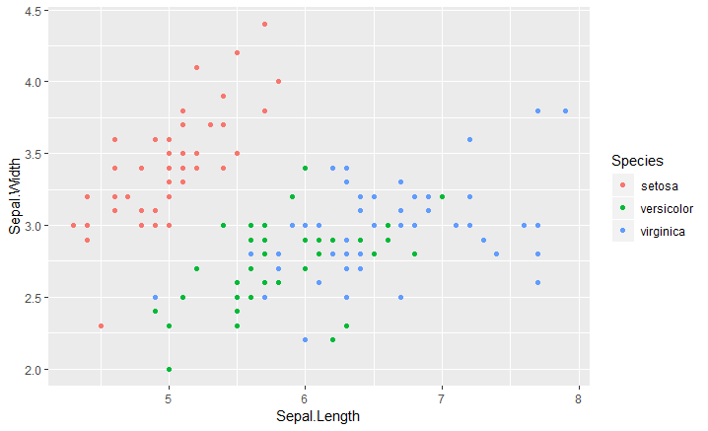
What if the response was multiclass?

Slide 23
What if the response was multiclass?
One-vs-all.
Basically, you repeat the logistic regression for every class vs all.
(ie setosa vs non-setosa, virginica vs non-virginica, versicolor vs non-versicolor)

Slide 24
What if the response was multiclass?
One-vs-all.
Basically, you repeat the logistic regression for every class vs all.
Classify as the top y.
E.g. Flower A:
Model Setosa: $\frac{1}{1+e^{−Xβ}}=0.3$
Model Virginica: $\frac{1}{1+e^{−Xβ}}=0.7$
Model Versicolor: $\frac{1}{1+e^{−Xβ}}=0.8$

Slide 25
Decision Trees
Conceptually simple method that assigns values based on a series of splits in the data.
Can model non-linear relationships and interactions between features.

Slide 26
Plot of sepal

Slide 27
Plot of sepal

Slide 28
Plot of sepal
Usually, splits determined by Gini impurity.

Slide 29
Sample Decision Tree
Sepal Length > 6?
Sepal Width
>2.75
Not Setosa
Not Setosa
Setosa

Slide 30
Decision Trees
Can model non-linear relationships and interactions between features.
No need for scaling
Internal feature selection
Prone to overfitting.

Slide 31
Random Forest
A collection of decision trees. Each tree votes and is either majority rules or weighted mean.
Sepal Length > 6?
Sepal Width
>2.75
Not Setosa
Not Setosa
Setosa

Slide 32
Random Forest
Each tree votes.

Slide 33
Random Forest
Each tree votes.

Slide 34
Random Forest
Each tree votes.

Slide 35
Random Forest
Each tree votes.

Slide 36
Random Forest
Each tree votes.
Data is subset for each tree.
Features to split by are selected randomly.

Slide 37
Random Forest
A collection of decision trees. Each tree votes and the average is taken.
This helps reduce overfitting, but we lose interpretability.
Easiest method to use OOTB.
Parameters: n_trees, criterion for splits, max_depth

Slide 38
K-Nearest Neighbors
Pay attention! You will be implementing this from scratch.
The K nearest neighbors in n-dimensional space “vote” for class labelling.

Slide 39
K-Nearest Neighbors

Slide 40
K-Nearest Neighbors

Slide 41
K-Nearest Neighbors

Slide 42
K-Nearest Neighbors

Slide 43
SVM
Fit an n hyperplanes dividing the data.
Choose the hyperplane so that the distance from it to the nearest data point on each side is maximized.

Slide 44
SVM
Very powerful.
Can easily overfit through poor parameter choices.
Regularization parameter (misclassifications),
Kernel parameter (linear etc).
Both are key. Fit correctly.

Slide 45
Evaluations

Slide 46
Evaluation
There are many ways to evaluate a classifier.
Very subjective, dependent on the data and the problem.

Slide 47
Iris Dataset
Dataset of flower measurements, 150 samples, 50 samples per class.
Classes:
Setosa (red)
Not setosa (grey / orange)

Slide 48
Evaluation
There are many ways to evaluate a classifier.
Example:
 | Flower #1 | Flower #2 | Flower #3
Prediction | Setosa | Not Setosa | Not Setosa
Truth | Setosa | Not Setosa | Setosa

Slide 49
Evaluation
There are many ways to evaluate a classifier.
Example:
Basic concepts:
true positive, true negative, false positive, false negative
 | Flower #1 | Flower #2 | Flower #3
Prediction | Setosa | Not Setosa | Not Setosa
Truth | Setosa | Not Setosa | Setosa

Slide 50
Evaluation
There are many ways to evaluate a classifier.
Example:
Basic concepts:
true positive, true negative, false positive, false negative
 | Flower #1 | Flower #2 | Flower #3
Prediction | Setosa | Not Setosa | Not Setosa
Truth | Setosa | Not Setosa | Setosa

Slide 51
Evaluation
There are many ways to evaluate a classifier.
Example:
Basic concepts:
true positive, true negative, false positive, false negative
 | Flower #1 | Flower #2 | Flower #3
Prediction | Setosa | Not Setosa | Not Setosa
Truth | Setosa | Not Setosa | Setosa

Slide 52
Evaluation
There are many ways to evaluate a classifier.
Example:
Basic concepts:
true positive, true negative, false positive, false negative
 | Flower #1 | Flower #2 | Flower #3
Prediction | Setosa | Not Setosa | Not Setosa
Truth | Setosa | Not Setosa | Setosa

Slide 53
Evaluation
There are many ways to evaluate a classifier.
Example:
Basic concepts:
true positive (TP), true negative (TN)
false positive (FP), false negative (FN)
 | Flower #1 | Flower #2 | Flower #3
Prediction | Setosa | Not Setosa | Not Setosa
Truth | Setosa | Not Setosa | Setosa

Slide 54
Evaluation
There are many ways to evaluate a classifier.
Example:
Accuracy. How often are we right.
$=\frac{TP+TN}{TP+FP+TN+FN}$ = 2/3
 | Flower #1 | Flower #2 | Flower #3
Prediction | Setosa | Not Setosa | Not Setosa
Truth | Setosa | Not Setosa | Setosa

Slide 55
Evaluation
There are many ways to evaluate a classifier.
Example:
Sensitivity (recall). Out of all actual positive cases, how many do we predict as positive?
$=\frac{TP}{TP+FN}$ = 1/2
 | Flower #1 | Flower #2 | Flower #3
Prediction | Setosa | Not Setosa | Not Setosa
Truth | Setosa | Not Setosa | Setosa

Slide 56
Evaluation
There are many ways to evaluate a classifier.
Example:
Specificity. Out of all actual negative cases, how many are predicted as negative?
$=\frac{TN}{TN+FP}$ = 1/1
 | Flower #1 | Flower #2 | Flower #3
Prediction | Setosa | Not Setosa | Not Setosa
Truth | Setosa | Not Setosa | Setosa

Slide 57
Evaluation
There are many ways to evaluate a classifier.
Example:
Precision. Out of all predicted positive, how many are actually positive?
$=\frac{TP}{TP+FP}$ = 1/1
 | Flower #1 | Flower #2 | Flower #3
Prediction | Setosa | Not Setosa | Not Setosa
Truth | Setosa | Not Setosa | Setosa

Slide 58
Evaluation
 | Flower #1 | Flower #2 | Flower #3
Prediction | Setosa | Not Setosa | Not Setosa
Truth | Setosa | Not Setosa | Setosa
F-Score. Combination of precision and recall.
Beta = 1: equal weight; 0.5: precision; 2: recall.
$$=\frac{\left(1+β^{2}\right)∗TP}{\left(1+β^{2}\right)∗TP+β^{2}∗FN+FP}$$

Slide 59
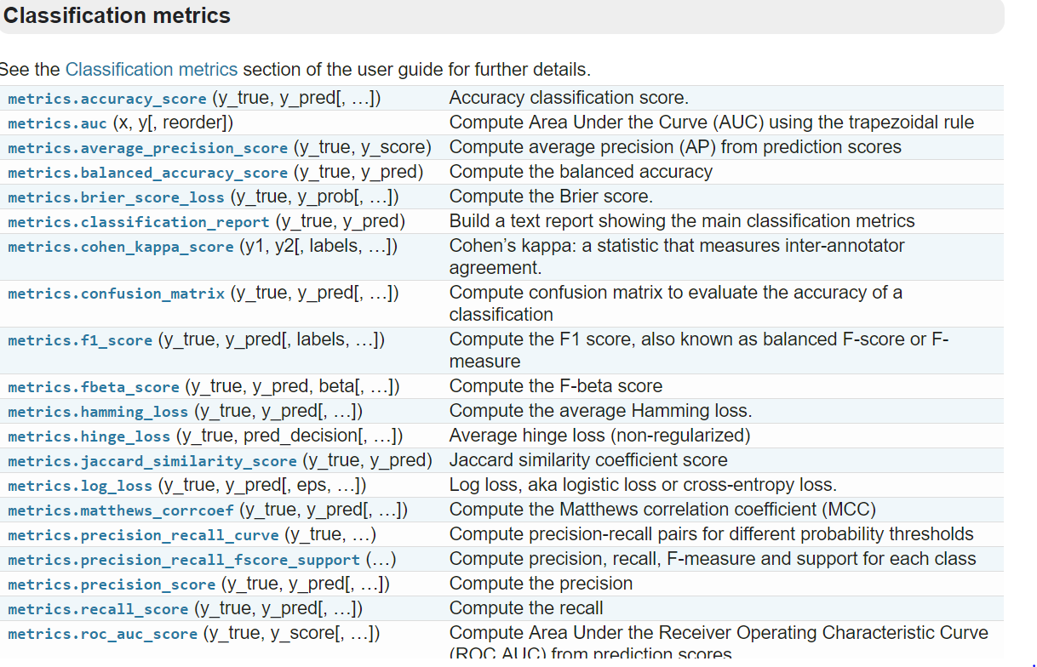
Evaluation
http://scikit-learn.org/stable/modules/classes.html#module-sklearn.metrics
f(y_true, y_pred)

Slide 60
Evaluation
 | Flower #1 | Flower #2 | Flower #3
Prediction | 0.7 | 0.1 | 0.54
Truth | Setosa | Not Setosa | Setosa
 | Flower #1 | Flower #2 | Flower #3
Prediction | Setosa | Not Setosa | Not Setosa
Truth | Setosa | Not Setosa | Setosa
Performance over all possible thresholds –
When you want to evaluate a score across thresholds.

Slide 61
Evaluation
 | Flower #1 | Flower #2 | Flower #3
Prediction | 0.7 | 0.1 | 0.54
Truth | Setosa | Not Setosa | Setosa
Receiver operating characteristic curve (ROC curve).
ROC curve illustrates the performance of a binary classifier system as its discrimination threshold is varied by plotting True Positive rate vs False Positive rate. It can also be referred to as a Sensitivity vs (1-Specificity) plot.

Slide 62
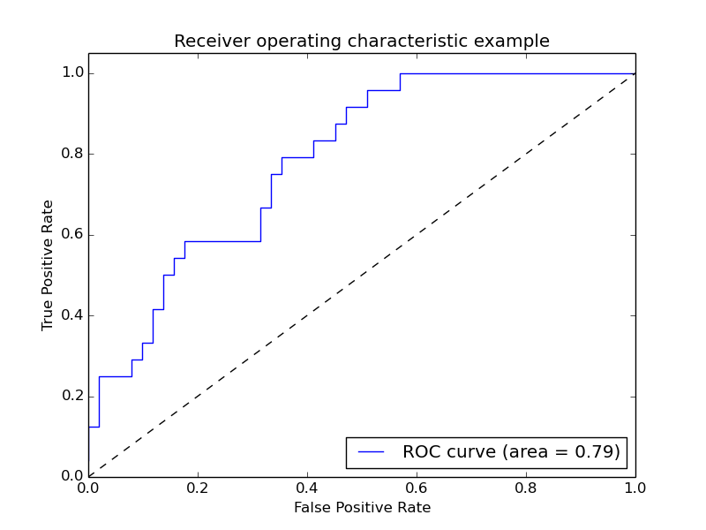
Evaluation
AUC:
Probability that a classifier will rank
a randomly chosen positive instance higher
than a randomly chosen negative one.
Be suspicious of ultra-high AUCs.

Slide 63
Evaluation
AUC:
ROC AUCs are very sensitive to class
imbalance.

Slide 64
Evaluation
1,000,000 flowers. 100 are setosas.
(This is an imbalanced dataset)

Slide 65
Evaluation
1,000,000 flowers. 100 are setosas.
Consider two classification methods:
Method 1: 100 marked setosas, 90 of those are setosas.
Method 2: 2000 marked setosas, 90 of those are setosas.

Slide 66
Evaluation
1,000,000 flowers. 100 are setosas.
Consider two classification methods:
Method 1: 100 marked setosas, 90 of those are setosas.
Method 2: 2000 marked setosas, 90 of those are setosas.
Clearly, Method 1 is far superior (though of course can be subjective).

Slide 67
Evaluation
1,000,000 flowers. 100 are setosas.
Consider two classification methods:
Method 1: 100 marked setosas, 90 of those are setosas.
TP=90; FP=10; TN=999,890; FN=10.
Method 2: 2000 marked setosas, 90 of those are setosas.
TP=90; FP=1910; TN=997,990; FN=10.

Slide 68
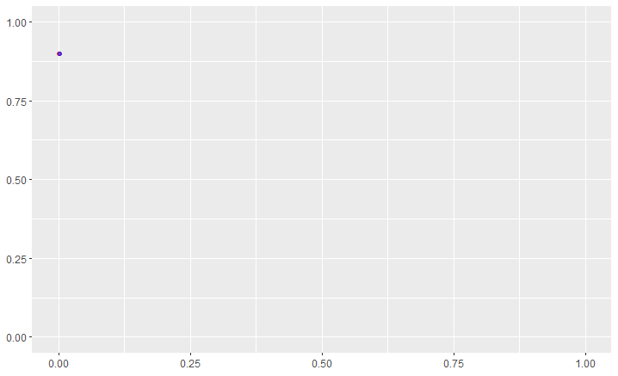
Evaluation
Method 1: 100 marked setosas, 90 of those are setosas.
Sensitivity (TPR): 0.9
1 – Specificity (FPR): 0.000010001
Method 2: 2000 marked setosas, 90 of those are setosas.
Sensitivity (TPR): 0.9
1 – Specificity (FPR): 0.00191

Slide 69
Evaluation
 | Flower #1 | Flower #2 | Flower #3
Prediction | 0.7 | 0.1 | 0.54
Truth | Setosa | Not Setosa | Setosa
Precision recall curve (PR curve).
PR curve illustrates the performance of a binary classifier system as its discrimination threshold is varied by plotting precision vs recall.

Slide 70
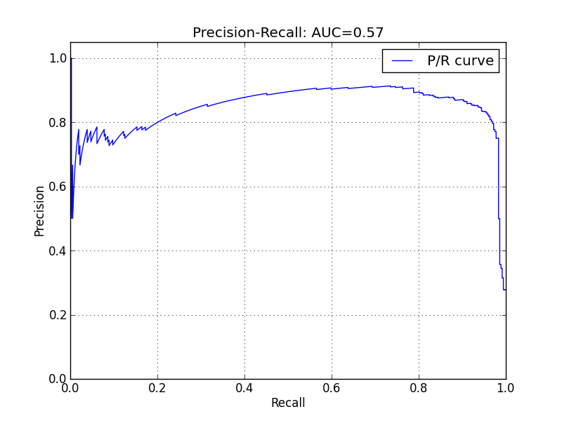
Evaluation
AUC:
Average precision across varying threshold.
Here too, be suspicious of ultra-high AUCs.

Slide 71
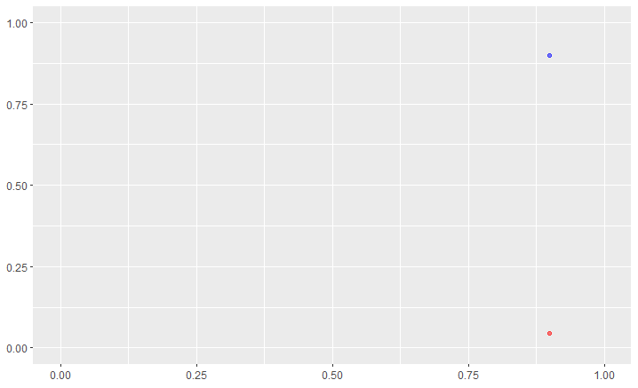
Evaluation
Method 1: 100 marked setosas, 90 of those are setosas.
Precision: 0.9
Recall: 0.9
Method 2: 2000 marked setosas, 90 of those are setosas.
Precision: 0.045
Recall: 0.9

Slide 72
Evaluation
One of the best ways to test whether the underlying data structure lends itself to high scores is by running some kind of a permutation test.
Shuffle the labels (e.g. setosa and non-setosa).
Calculate score.
Repeat.
You’ve created a null distribution.

Slide 73
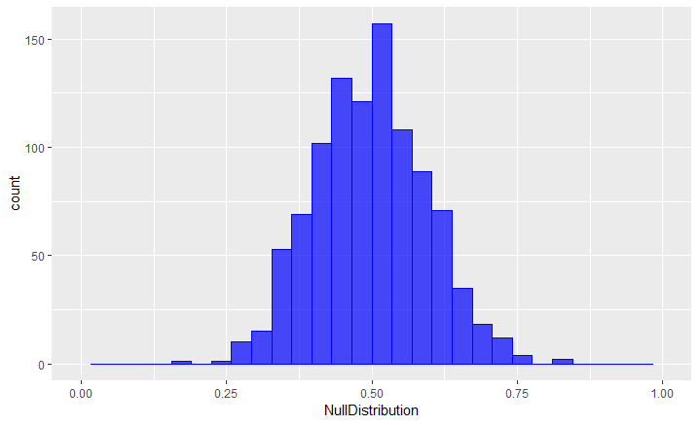
Evaluation

Slide 74
Evaluation
AUC: 0.89

Slide 75
Evaluation
AUC: 0.89
Permutation P-val:
$$\frac{n_{p}−X+1}{n_{p}+1}$$
Where X is:
# AUCs < True AUC
$$\frac{n_{p}−X+1}{n_{p}+1}=\frac{1000−1000+1}{1000+1}=\frac{1}{1001}≈0.001$$

Slide 76
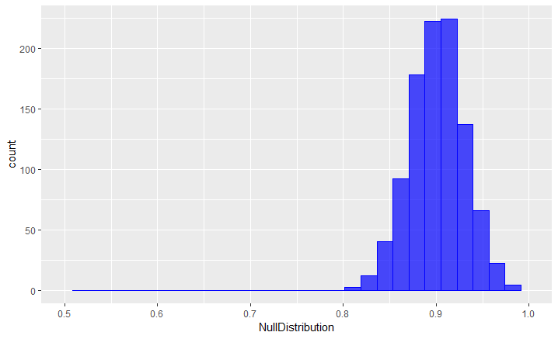
Evaluation
AUC: 0.89
Permutation P-val:
$$\frac{n_{p}−X+1}{n_{p}+1}$$
Where X is:
# AUCs < True AUC
$$\frac{n_{p}−X+1}{n_{p}+1}=\frac{1000−346+1}{1000+1}=\frac{655}{1001}≈0.65$$

